Slide 1
DEPARTMENT OF PHYSICS
SRM INSTITUTE OF SCIENCE AND TECHNOLOGY
18PY103J – Physics: Semiconductor Physics
Module-I, Lecture-15
Influence of Acceptor in Semiconductors
18PYB101J Module-I Lecture-15
18PYB103J Module-I Lecture-1

Slide 2
  Influence of acceptors in semiconductors
  Consider adding a group III element, such as boron, as a substitutional impurity to silicon. The group III element has three valence electrons, which are all taken up in the covalent bonding. As shown in Figure a.
  one covalent bonding position appears to the empty. If an electron were to occupy this "empty" position its energy would have to be greater than that of the valence electrons, since the net charge state of the boron atom would now be negative.
  However, the electron occupying this "empty" position does not have sufficient energy in the conduction band, so its energy is far smaller than the conduction-band energy.
18PYB101J Module-I Lecture-15

Slide 3
  Influence of acceptor in semiconductors
    The "empty" position associated with the boron atom becomes occupied, and other valence electron positions become vacated. These other vacated electron positions can thought of as holes in the semiconductor material.
    Figure b. shows the expected energy state of the "empty" position and also the formation of a hole in the valence hand. The hole can move through the crystal generating a current, while the negatively charged boron atom is fixed in the crystal.
    The group Ill atom accepts an electron from the valence band and so is referred to as acceptor impurity). atom. The acceptor atom can generate holes in the valence hand without generating electrons in the conduction band. This type of semiconductor material is referred to as a p-type material (p for the positively charged hole).
18PYB101J Module-I Lecture-15

Slide 4
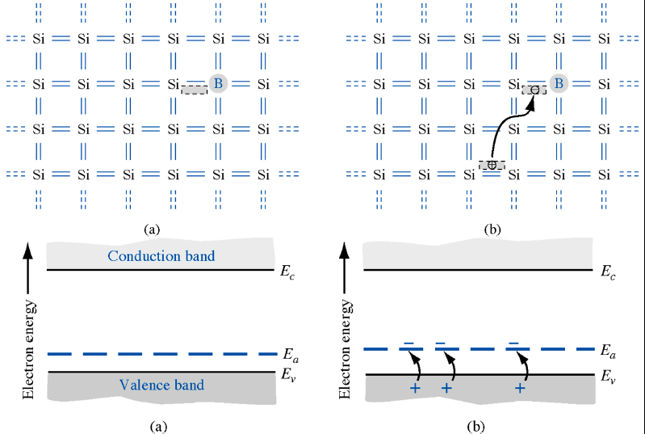
  Influence of acceptor in semiconductors
18PYB101J Module-I Lecture-15

Slide 5
Non-equilibrium carrier densities
we have only considered the thermal equilibrium carrier densities, n_{o} and p_{o}. However most devices of interest are not in thermal equilibrium. Keep in mind that a constant ambient constant temperature is not a sufficient condition for thermal equilibrium.
In fact, applying a non-zero voltage to a device or illuminating it with light will cause a non-equilibrium condition, even if the temperature is constant.
To describe a system that is not in thermal equilibrium we assume that each of the carrier distributions is still in equilibrium with itself. Such assumption is justified on the basis that electrons readily interact with each other and interact with holes only on a much longer time scale.
18PYB101J Module-I Lecture-15

Slide 6


Non-equilibrium carrier densities
The electron density can still be calculated using the Fermi-Dirac distribution function, but with a different value for the Fermi energy. The total carrier density for a non-degenerate semiconductor is then described by:
Where d_{n} is the excess electron density and F_{n} is the quasi-Fermi energy for the electrons. Similarly, the hole density can be expressed as:
Where dp is the exces hole density and F_{p} is the quasi-Fermi energy for the holes.
18PYB101J Module-I Lecture-15

